Slide 1
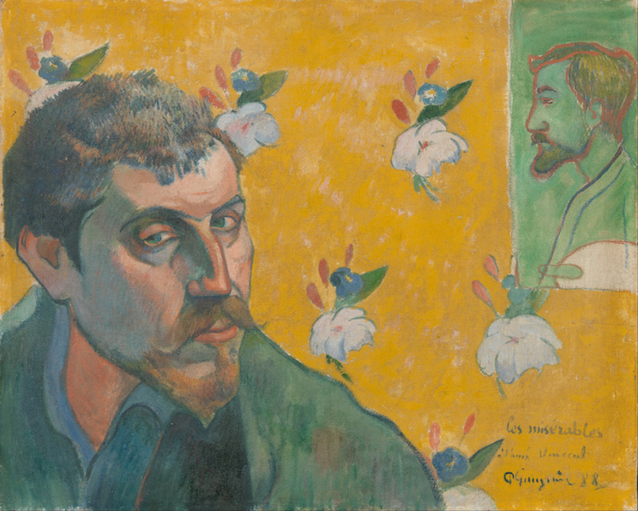
Paul Gauguin
(1848 – 1903)
France
History of Modern Art
BFA-III (Visual Arts)
Course Incharge: Ms. Sidra Liaqat
Institute of Design & Visual Arts, LCWU

Slide 2
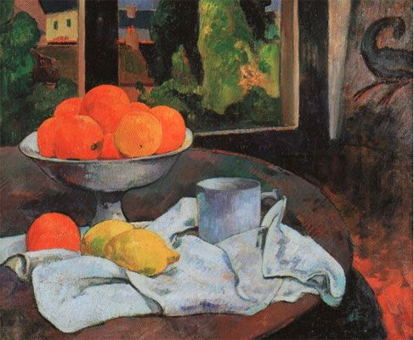
“Still-Life with Fruits and Lemon”
(1880)

Slide 3
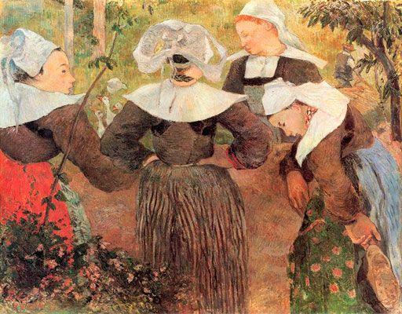
“I am trying to put into these desolate figures the savagery that I see in them and which is in me too... I want to consult nature as well but I don't want to leave out what I see there and what comes into my mind.”
- Paul Gauguin
“Four Breton Girls”
(1886)

Slide 4
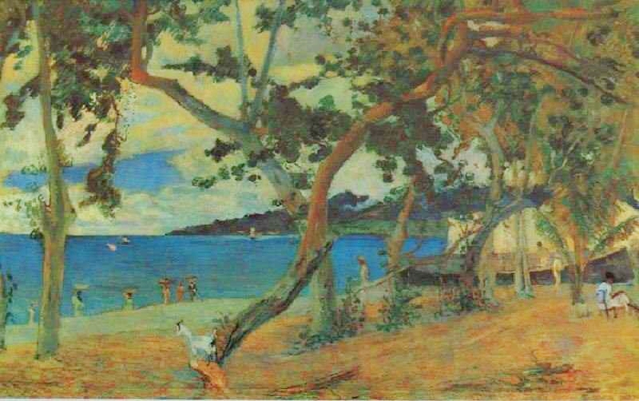
“St. Peter’s Bay, Martinique”

Slide 5
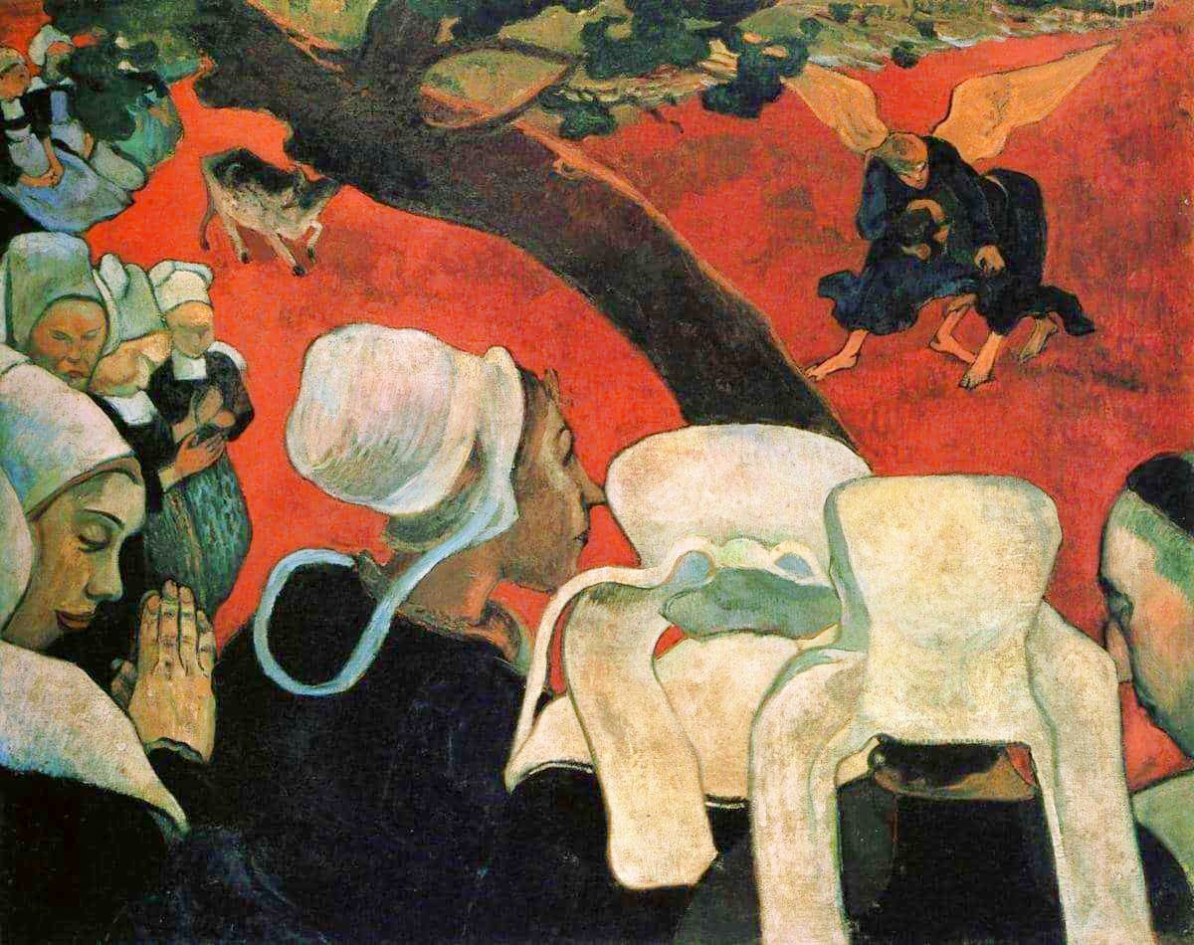
“The Vision After the Sermon” /
“Jacob Wrestling with the Angel”
(1888)

Slide 6
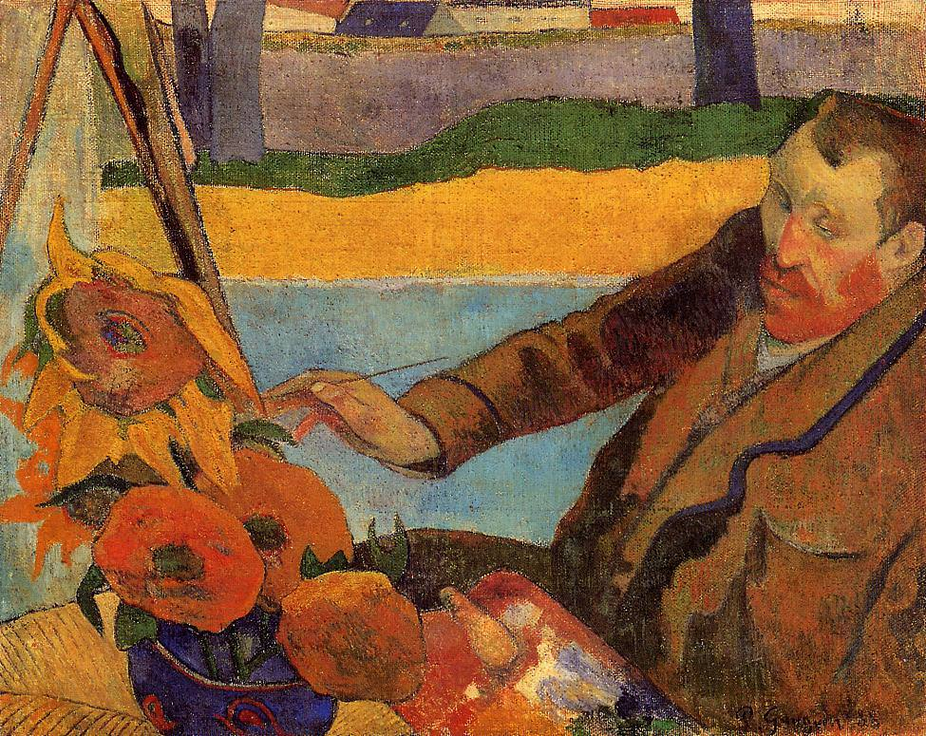
“The Painter of Sunflowers”
(1888)

Slide 7
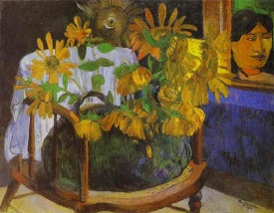

Slide 8
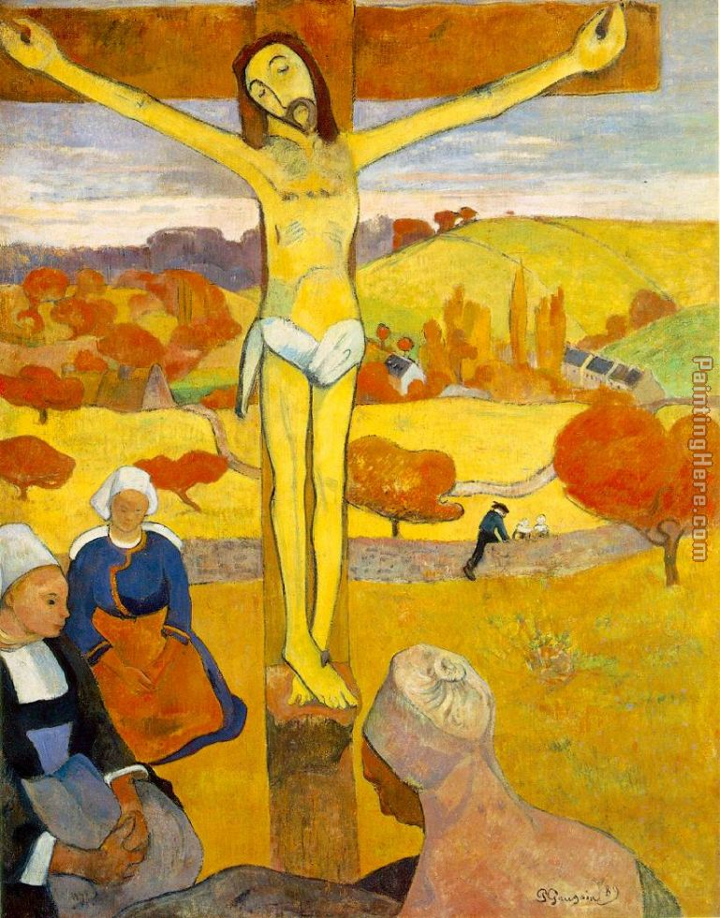
“The Yellow Christ”
(1889)

Slide 9
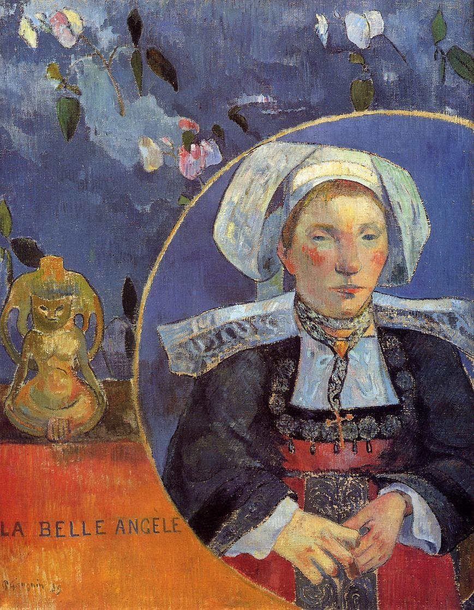
“La Belle Angèle”
(1889)

Slide 10
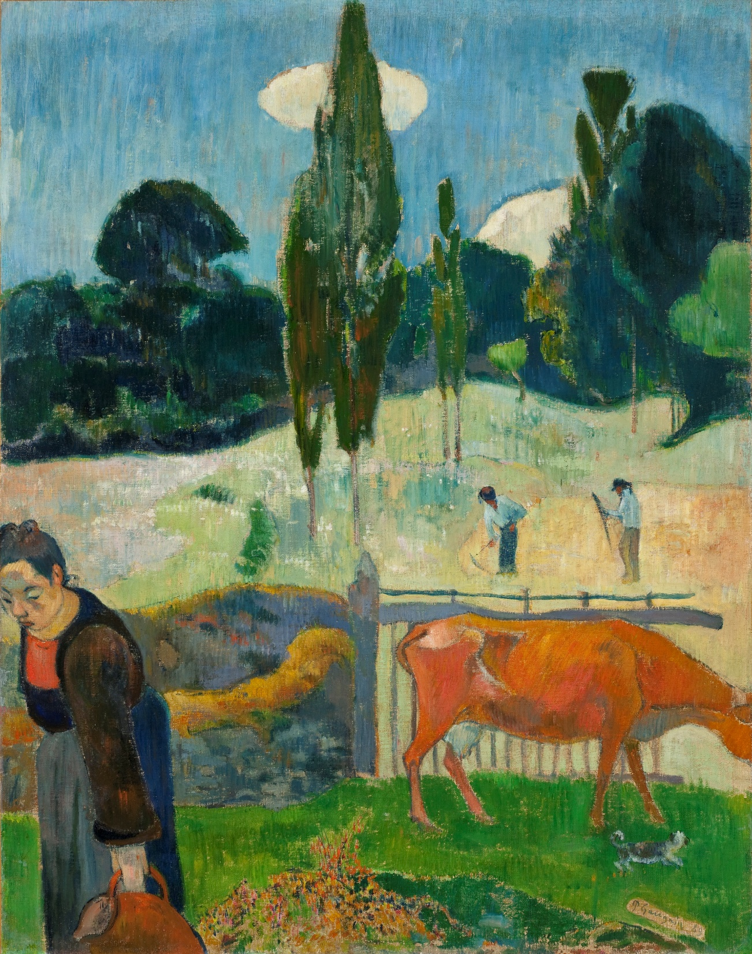
“The Red Cow”
(1889)

Slide 11
“I have escaped form everything artificial… Here I enter into
truth… After the disease of civilization, life in this new world,
is a return to health.”

Slide 12
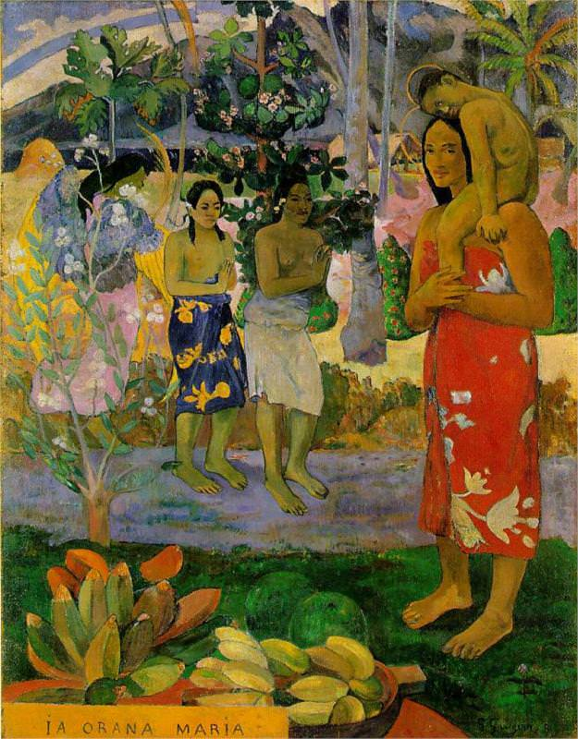
“We Hail Thee Mary”
(1891)

Slide 13
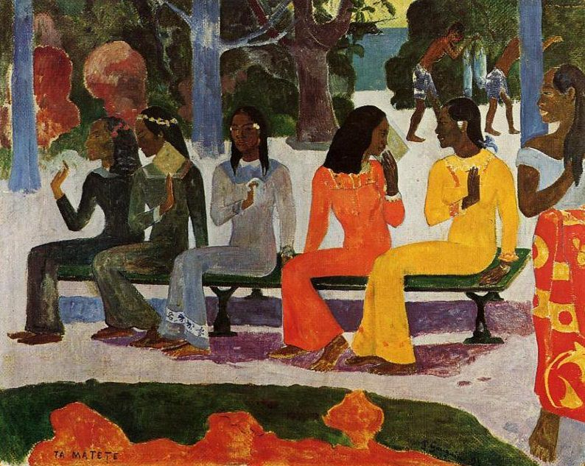
“Ta Matete”
(1892)

Slide 14
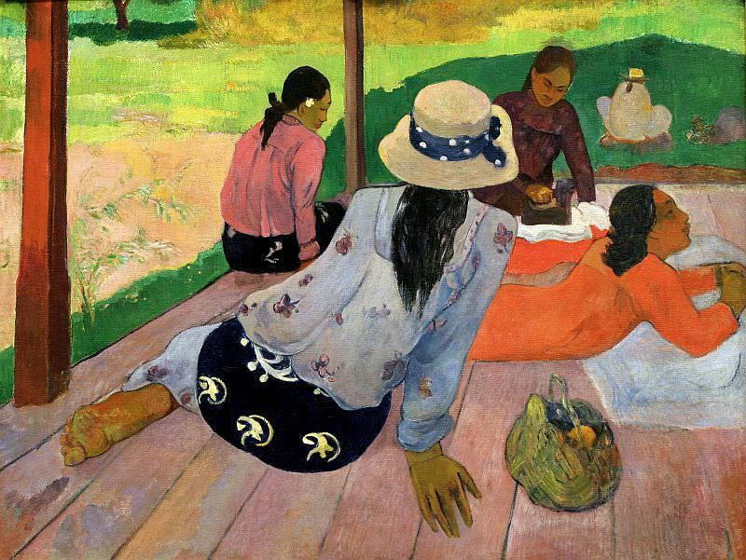
“Siesta”
(1893)

Slide 15
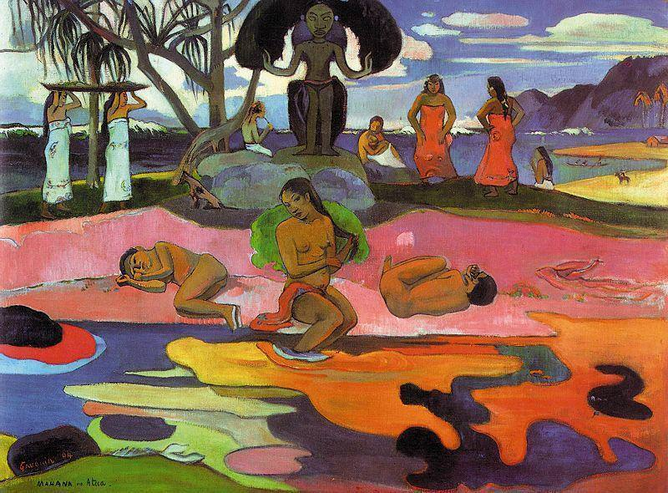
“The Day of the God”
(1894)

Slide 16
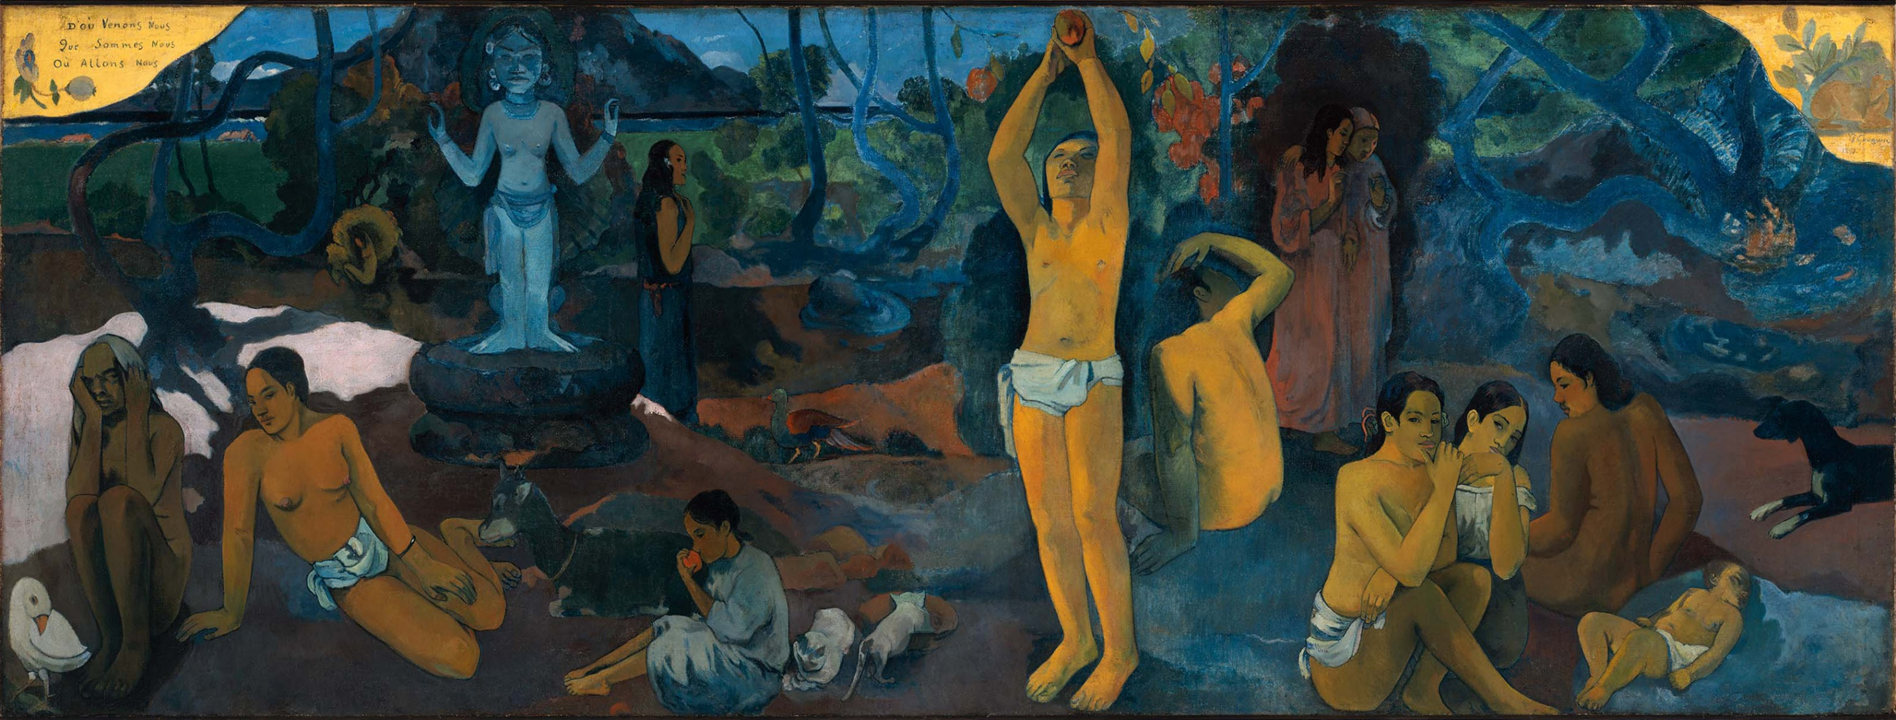
“Where do we come from? What are we? Where are we going?” (1897)
https://da.khanacademy.org/humanities/ap-art-history/later-europe-and-americas/modernity-ap/a/gauguin-where-do-we-come-from-what-are-we-where-are-we-going

Slide 17
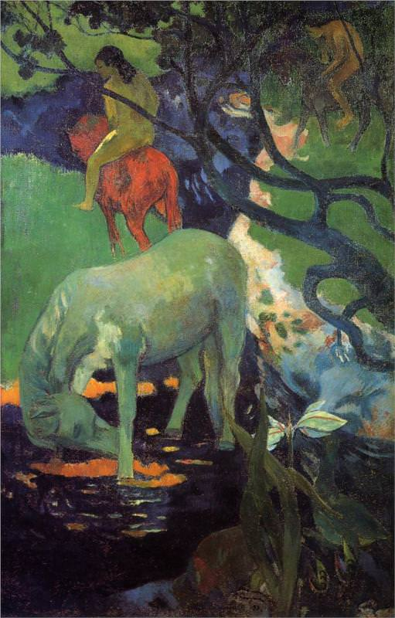
“The White Horse”
(1898)

Slide 18
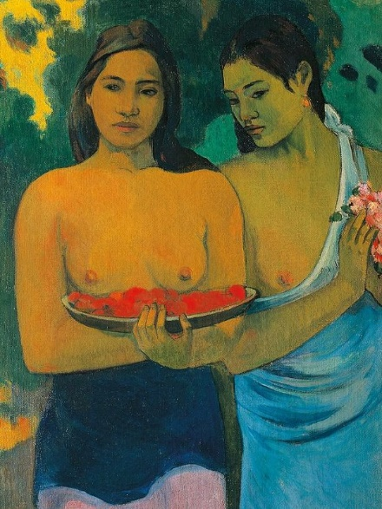
“Tahitian Girls with Flowers”
(1899)

